Slide 1
Augmented Reality: Travel and Toursim
Presented By:
Arvind Sheri
Sharath Koppu
V Bhanu Sudheer
Aditya Soman

Slide 2
Introduction
Deals with Travel and Tourism.
Especially useful for a tourist travelling to another country where different languages are spoken.
Implementing a Login/Register page; and a google oAth as an option.
Integrating Google Maps and Translate api’s to the application.
Will integrate a weather api also.
Will include a First Aid instruction manual in the future.

Slide 3
Start Page
Included a Register/Login page where the user can register their username and password.
Implemented a Google oAuth 2.0 login as an option also.

Slide 4
Main Page
The user after logging in is directed to this page.
All the activity is centered in this page.
Implemented a text to text language translator using Watson .
User has to select the from and to languages from a dropdown.
User will enter the text to be translated and click on a translate button.
The application will translate the text and display the translated text.
User will also have the option to logout once used.

Slide 5
Future increment
Will implement a auto location detect so that the From Language will automatically be detected; although the user will still have an option to select.
Will implement a weather api, based on the user’s location.

Slide 6
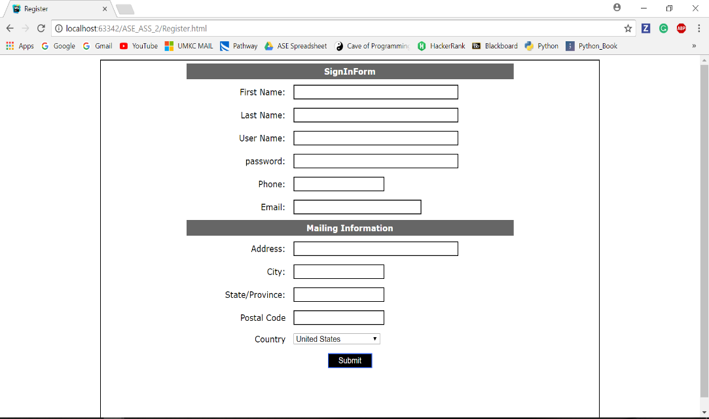
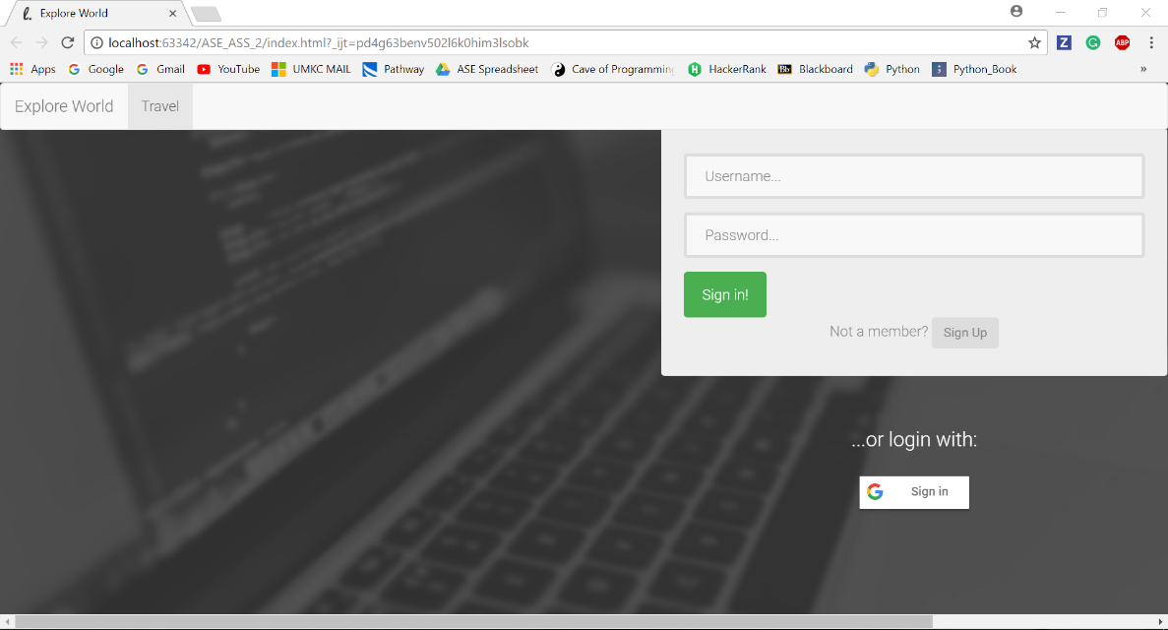
Related Images
Register Screen
Login screen

Slide 7
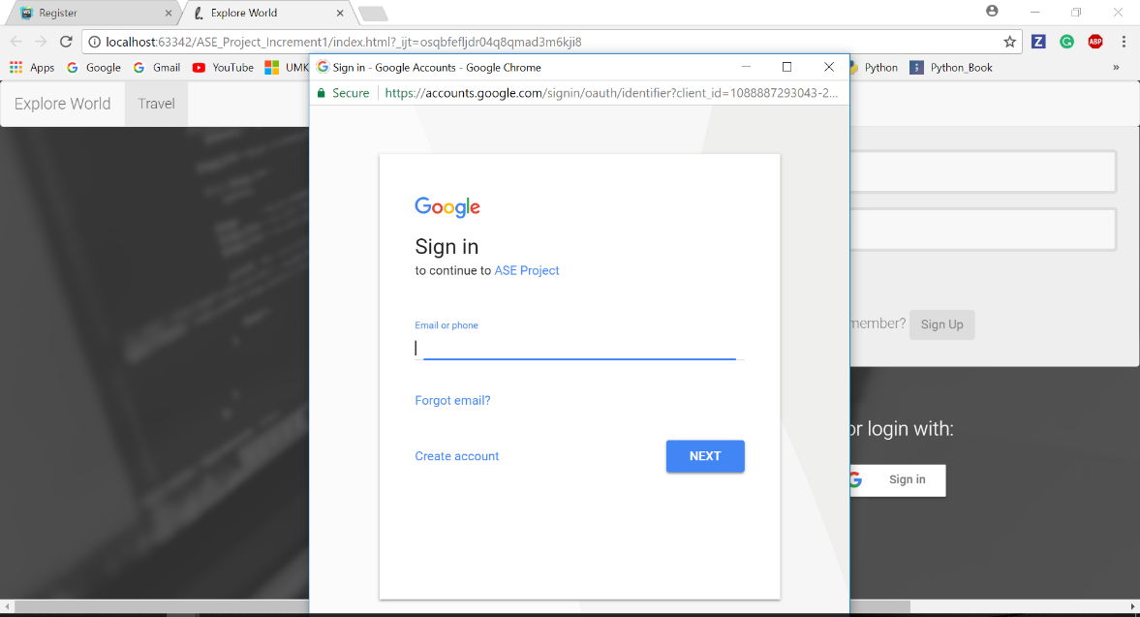
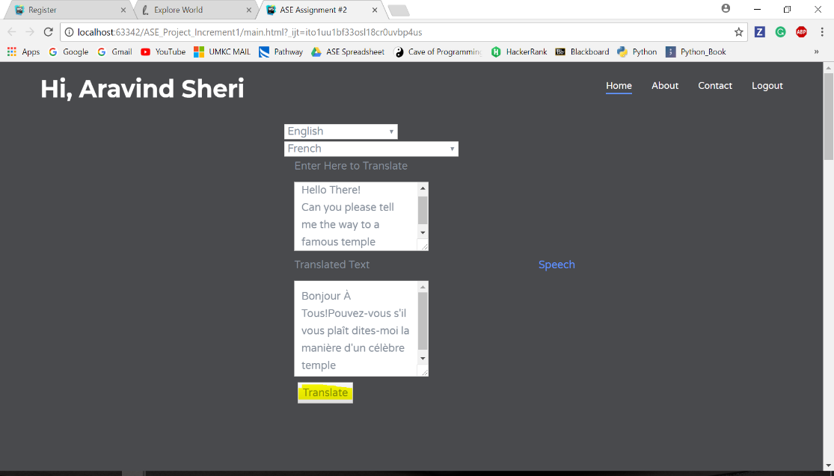
Related Images
Google oAuth 2.0
Main Page

Slide 8
Thank You!!!

